Slide 1

INTERNET OF THINGS AS A DRIVER OF CONSUMER GOODS INDUSTRY TRANSFORMATION
STUDENT: MAKSIM LAVRENTEV (МУН161) | SUPERVISOR: LILIANA PROSKURYAKOVA

Slide 2
RELEVANCE
NUMBER OF IoT DEVICES
Source: Gartner. Statista, 2016

Slide 3
IOT DEFINITION
Internet of Things is a conceptual framework that leverages on the availability of heterogeneous devices and interconnection solutions, as well as augmented physical objects providing a shared information base on global scale, to support the design of applications involving at the same virtual level both people and representations of objects
Source: Atzori et al., 2017

Slide 4












DOMAINS OF IOT APPLICATIONS
HUMAN
SMART HOME
RETAIL
OFFICE
ENERGY
WORKSITES
TRANSPORTATION
SMART CITY
VEHICLES
AGRICULTURE
FACTORY
MILITARY
FMCG industry is influenced by IoT applications in almost ALL of these domains!
The aim of the research is to map IoT applications in FMCG value chain and find the ones with greater potential

Slide 5
FMCG SPECIFICS
FMCG – Fast Moving Consumer Goods
Non-durable, everyday products
Short shelf life
Often intended for immediate consumption
Examples: food, beverages, personal hygiene and household cleaning utensils
FMCG industry
$8 trillion in 2014
Manufacturers, distributors, retailers, consumers
Major share of market is divided between large international companies
Highly innovative environment
Source: Hirose et al., 2015

Slide 6
RESEARCH STRUCTURE
PROBLEMATIC QUESTIONS
What are the current consumer and non-consumer applications of the IoT in the FMCG industry?
In which areas of the FMCG industry the IoT can bring the most value?
HYPOTHESES
The IoT is one of the key technologies in FMCG industry that will allow its transformation
IoT implementation in FMCG has great potential in optimization of the internal processes, whereas consumer applications of IoT in FMCG are limited

Slide 7
METHODOLOGY AND APPROACH
KEY METHODS
SPECIFICS
Sources Types: primary and secondary – original research articles in scientific journals, books, consulting reports, articles in periodicals
Data bases: Google Scholar, Science Direct, consulting companies websites, web versions of periodicals
Years: 2010 – 2017
LITERATURE REVIEW
Collective and illustrative cases
Sources: articles in scientific journals and periodicals, publicly available companies’ data
CASE STUDY

Slide 8
KEY FINDINGS

Slide 9

IOT IN FMCG INDUSTRY
AREAS FOR IOT APPLICATIONS
PRODUCT SUPPLY
RETAIL
CONSUMER

Slide 10
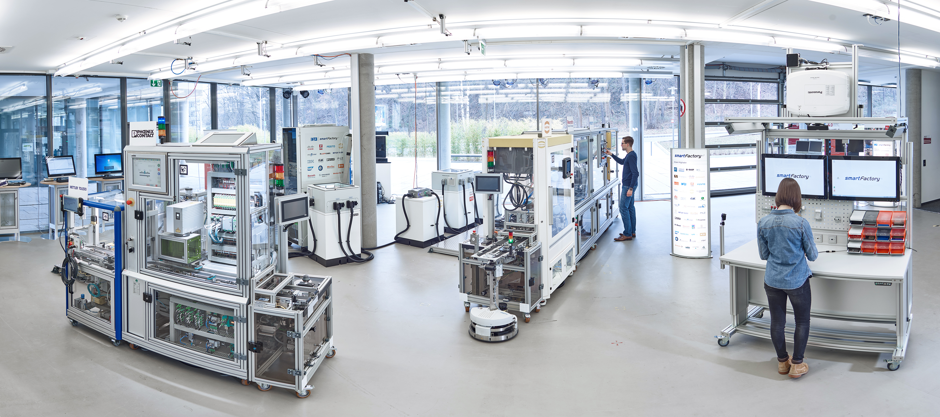
IOT IN FMCG PRODUCT SUPPLY
Key areas for IoT implementation
Process synchronization
Warehousing and transportation optimization
Predictive Maintenance
Increased process parameters visibility
Key technologies
RFID
Sensors
Augmented Reality
Key effects
OPEX and cash improvement
Productivity increase
Safety and reliability improvement
Example – SmartFactory^{KL}
Modular production cells
RFID in products and in production units machines
IT infrastructure connecting all devices
Flexible maintenance with Bridge Module
Product independent – initially designed for soap production, redesigned to assembly line
Source: Zuehlke, 2010; http://smartfactory.de

Slide 11
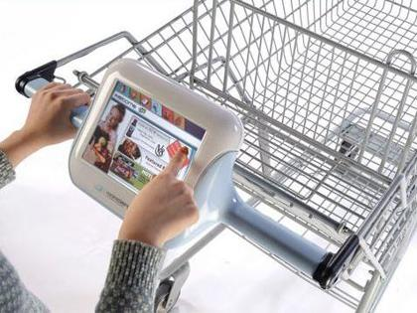
IOT IN RETAIL
Key areas for IoT implementation
Targeted offers and recommendations
Dynamic price adaptation
Inventory tracking
Warehousing and transportation optimization
Key technologies
Wearables
RFID
Sensors
Augmented Reality
Key effects
Sales increase
OPEX and cash improvement
Inventory turnover optimization
Example – Smart Cart
Consumer identification for targeted offers
Use of RFID for products identification to enable instant payment and product recommendations
In-store navigation system
Consumer behavior tracking
Source: Manyika et al., 2015

Slide 12
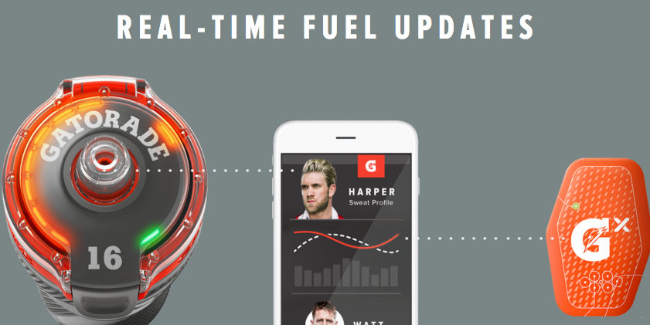
CONSUMER APPLICATIONS OF IOT
Example – Gatorade Hydration Platform
Leveraging IoT and Data Analysis for helping professional sportsmen
Made jointly by PepsiCo and Smart Design
Business model innovation vs. ordinary Gatorade products in:
Value proposition (service instead of product)
Key partners (hardware and software manufacturers)
Channels
Customer relationship
Customer segment etc.
Source: http://www.gatorade.com/FuelLab/

Slide 13
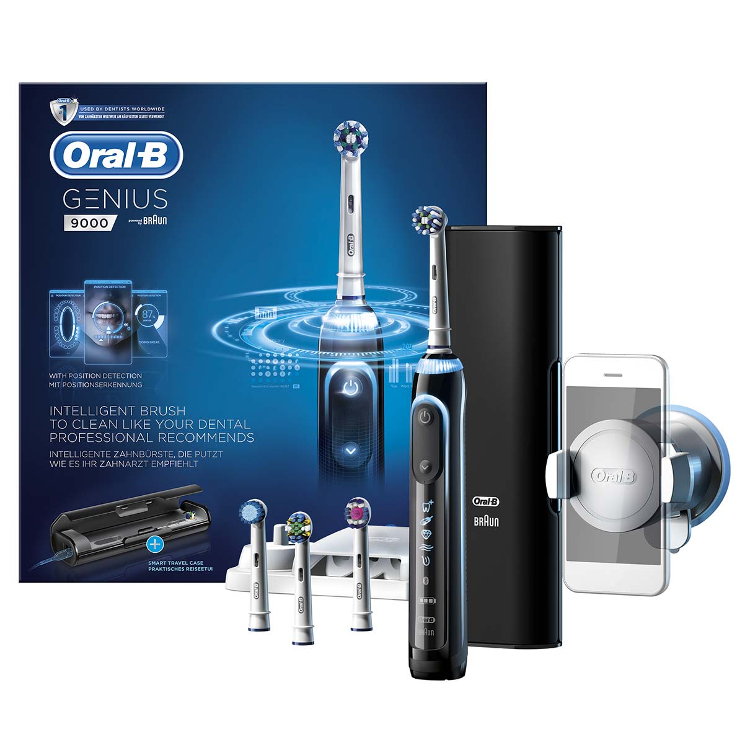
CONSUMER APPLICATIONS OF IOT
Example – Oral B Genius
Leveraging IoT for improving consumers’ oral care habits
Smartphone is used for brushing technic analysis, presentation of personal oral care analytics and consumer engagement through gamification
Not FMCG! But potentially opens direct communication channel to consumer for adjacent products (dentifrice, oral rinse, flosses etc.) promotion and data collection on consumer habits

Slide 14
SPECIFICS OF CONSUMER IOT IN FMCG
IOT applications are very limited due to FMCG specifics
Possible to develop non-FMCG IoT devices that will help FMCG business
Business model transformation is needed to realize the potential of IOT in FMCG
Consumer privacy, security and safety threat is the main barrier for using full potential of consumer IoT applications
Hard to identify value of IoT device for general consumer

Slide 15






KEY SUCCESS FACTORS FOR IOT IN FMCG
Availability of highly proficient in hardware/software/infrastructure/data analysis people
Enhancement of internal IT infrastructure
Close relationships with all stakeholders within FMCG supply chain
Complex partnerships with IT and product development organizations
Transformation of existing business models
Early start

Slide 16
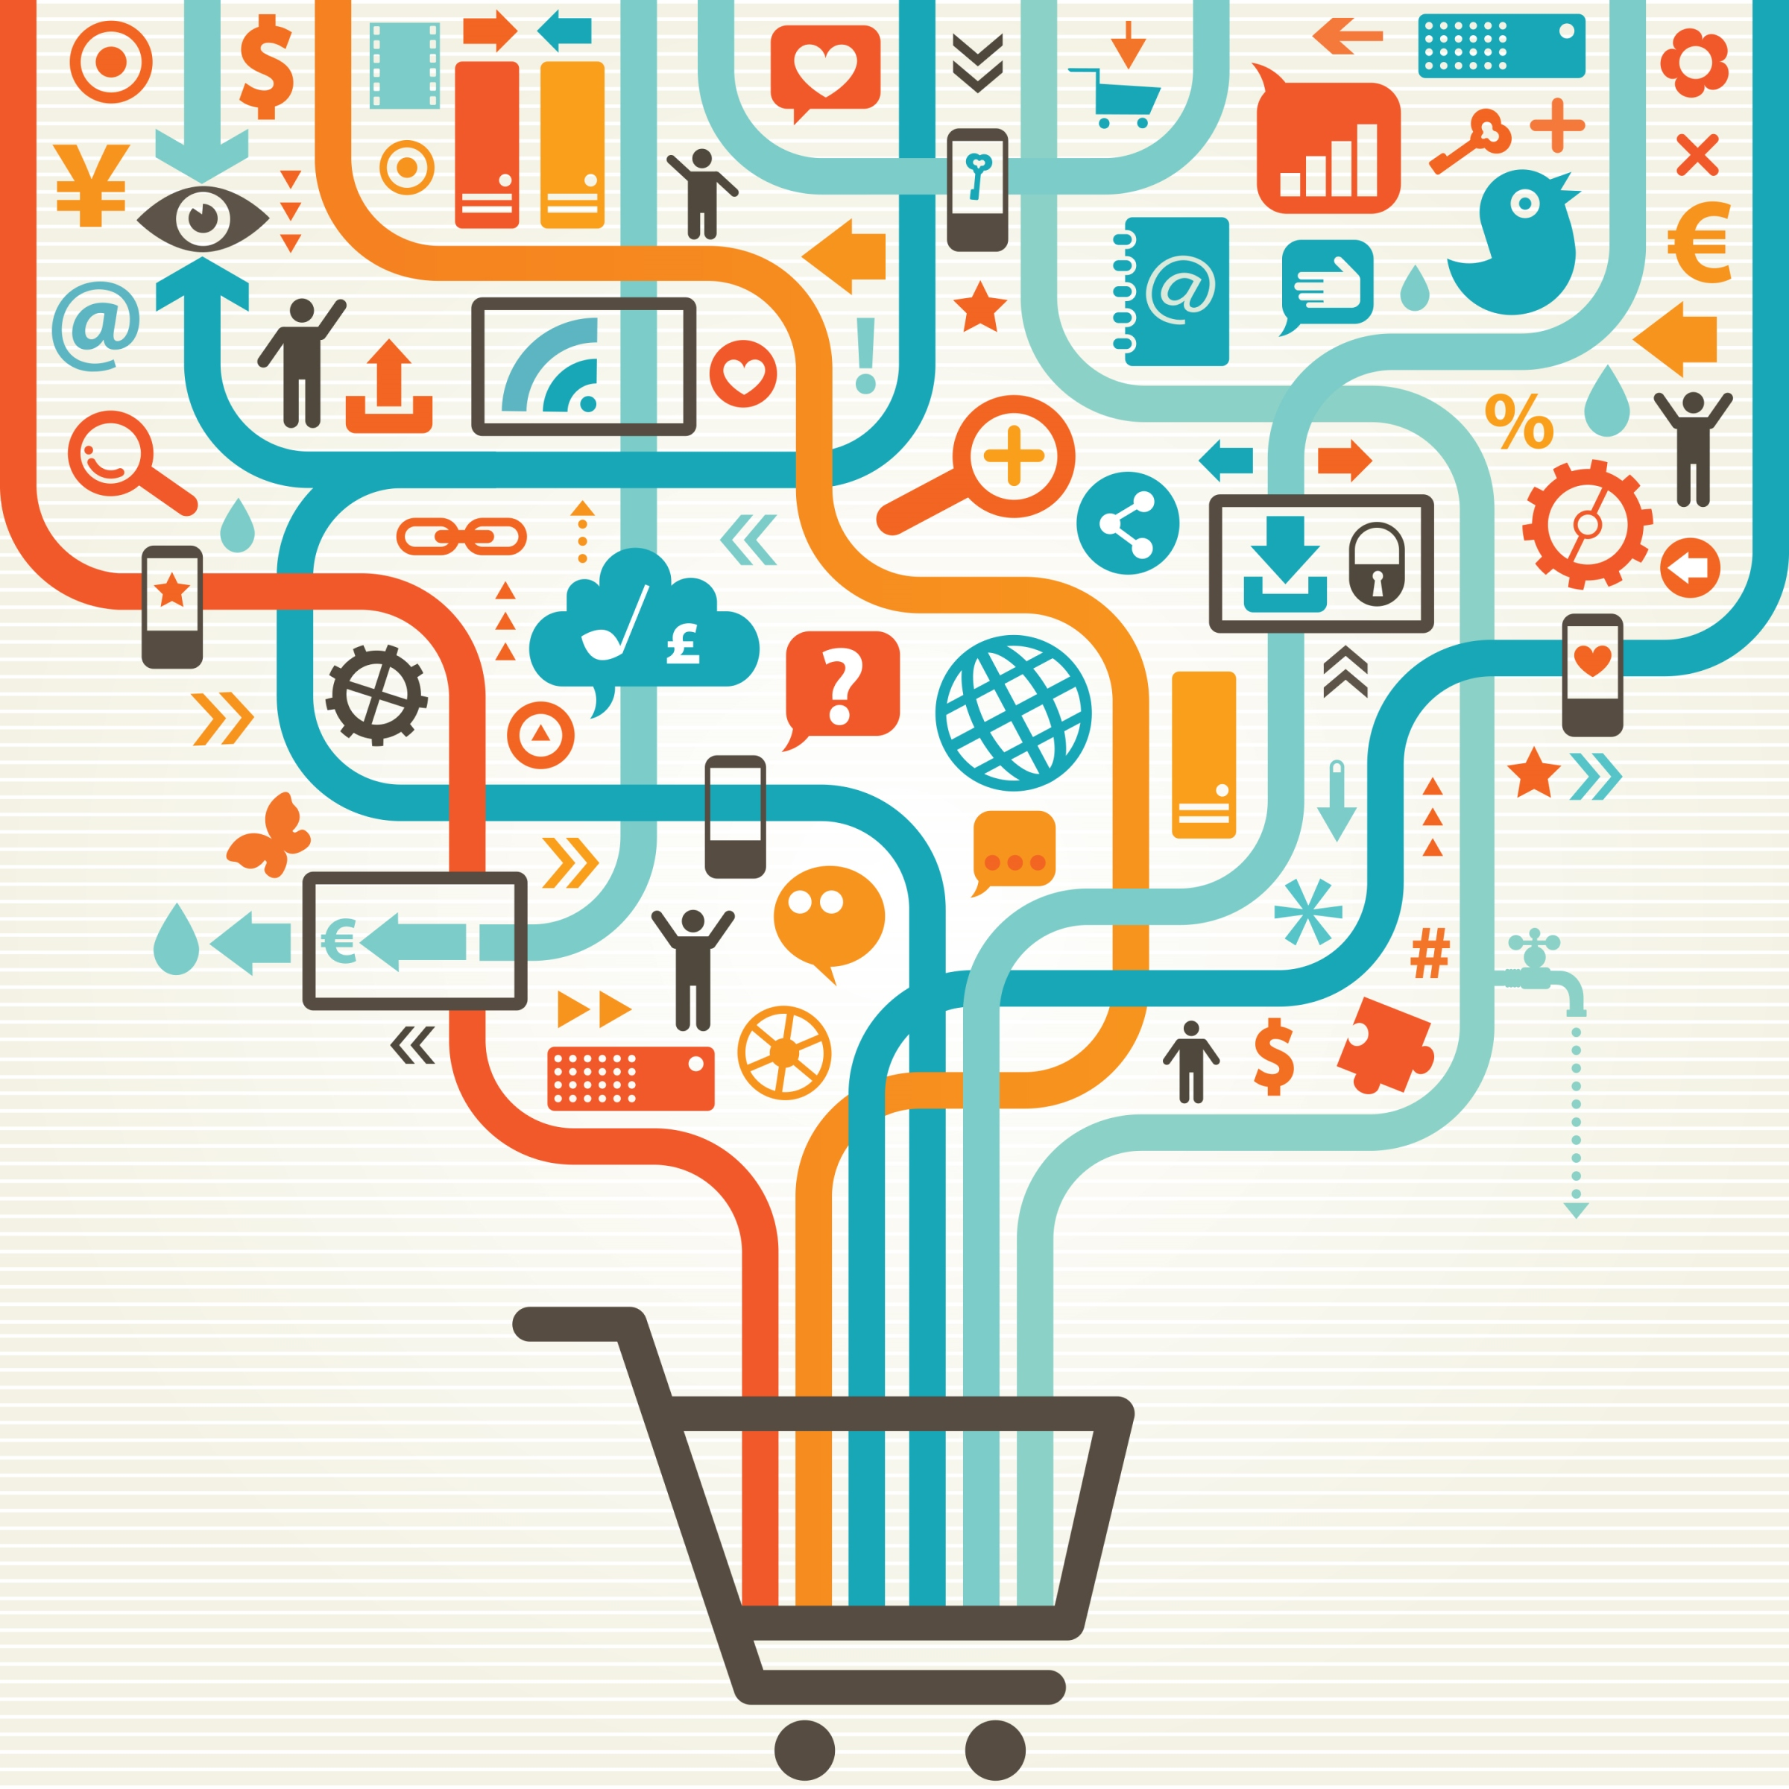
CONCLUSION
IoT is transforming the FMCG industry by:
Influencing consumers purchasing decision in store
Optimizing and modifying production and logistics processes
Transforming companies’ business models with introduction of new products and services
However, the greatest potential of the IoT can be found in industrial setting of FMCG as consumer applications are limited.

Slide 17
THANK YOU FOR YOUR ATTENTION!

